Slide 1
Online Voting System Using Face Recognition
Project Adavisor: Dr.Kashif Ishaq

Slide 2
THE TEAM
Muhammad Tazeem Sajid
Hamza Mudassir
Sohaib Naveed
F2019065042
S2020105012
F2019105092
Ghullam Mustafa
F2019065103

Slide 3
TABLE OF CONTENTS
01
04
Problem Statment
Technologies
02
05
Solution of the Problem
Scop of project
03
06
About Project
Requirements

Slide 4
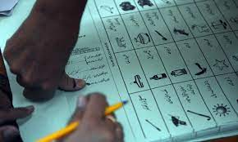
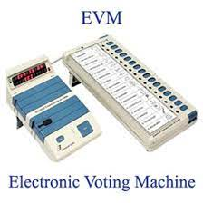
Problem Statment

Slide 5
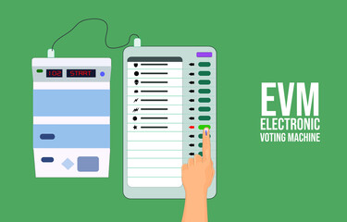
Problem with EVM
Lack of transparency
Security concerns
Technical failures
Cost
Accessibility
Lack of paper trail

Slide 6
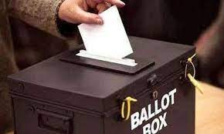
Problem With Ballot Paper
Cost
Voter error
Inaccuracies
Inaccuracies
Accessibility
Corruption

Slide 7
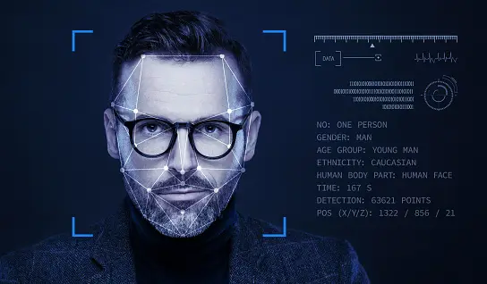
Solution of The Problem

Slide 8
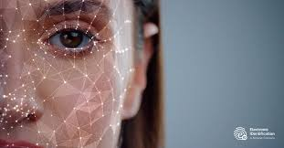
About Project
An online voting system using face recognition technology is an innovative approach to conducting secure and accessible elections. This system allows voters to cast their votes online from anywhere in the world using their mobile devices or computers, while also ensuring the integrity of the election process. The system incorporates facial recognition technology to authenticate voters, preventing fraud and ensuring that only eligible voters can cast their votes.

Slide 9

Architecture
The online voting system using face recognition consists of three main components: the user interface, the facial recognition module, and the voting module. The user interface is the front-end application that allows voters to access the system and cast their votes. The facial recognition module is the back-end application that verifies the identity of the voter, while the voting module stores and processes the votes.

Slide 10

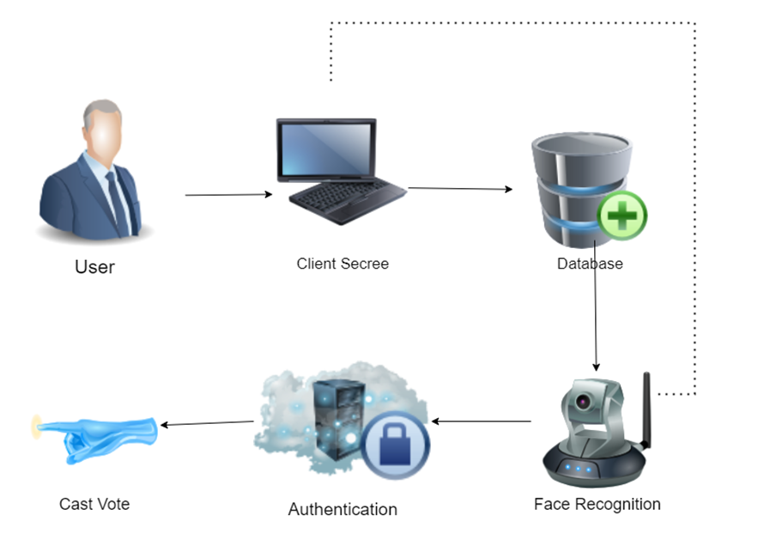
Working of Project

Slide 11

Scope of Project
System design and development
Voter registration and authentication
Ballot creation and voting
Security and privacy
Testing and evaluation
Legal and regulatory compliance

Slide 12

Functional Requirement
Admin Requirement:
(The admin can add create delete voting pool in the system).
End user Requirement:
(End user can register and cast vote and have the functionality for update their profile and give feedback against system.).
System Requirement:
( Voting system provide functionality to generate result and search functionality for admin to search specific pool and logout functionality provide to end user

Slide 13

Non-Functional Requirement
Accuracy of Face Recognition | The face recognition algorithm has a high accuracy rate to ensure reliable voter authentication. It refuse the unauthorized access for casting vote.
Security | The system should comply robust security measure to protect user data, prevent unauthorized access and insure ballot integrity
Performance | The system should handle the high volume of concurrent user during voting period that not decrease the performance of the system. Response time should be fast and efficient.
Scalability | The system should be scalable if an increasing number of voters without compromising performance. It should handle the growing database load.
Reliability | The system should reliable and available for user to access and use during the voting period. It should handle system failures, data backup and disaster recovery
Compatibility and accessibility | The system should be compatible with different web browser and accessible across different devices like mobile, tablet and desktops or laptop

Slide 14
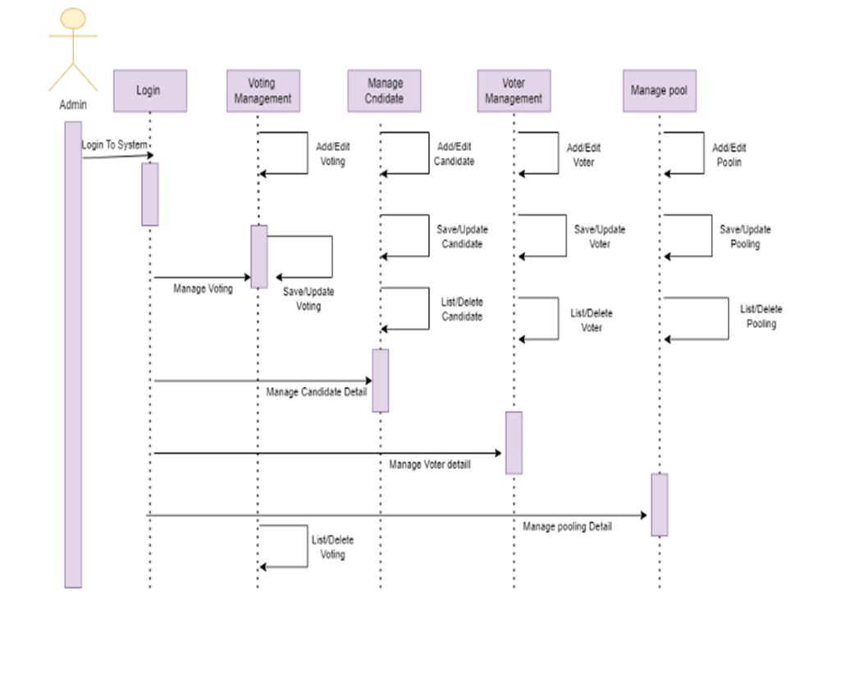
Sequence Diagram

Slide 15

Beneficial's
Voters
Election officials
Political parties and candidates
Governments
Technology providers

Slide 16

Tool Technologies
1. Programming Languages:
The system may be developed using programming languages NodeJS, JScript,,React, boot strap.
2. Database Management System:
A secure database management system Mongo DB will be used to store voter information and voting records.
3. Security Measures:
The system will require various security measures such as encryption, secure authentication(2 factor ), and firewalls to prevent hacking, tampering, or unauthorized access.
4. Testing Frameworks:
The system will require testing frameworks such as Selenium, Pytest, or Unittest to ensure the accuracy, reliability, and usability of the system.
5. Hardware:
Mobile and computer with better data connection required

Slide 17
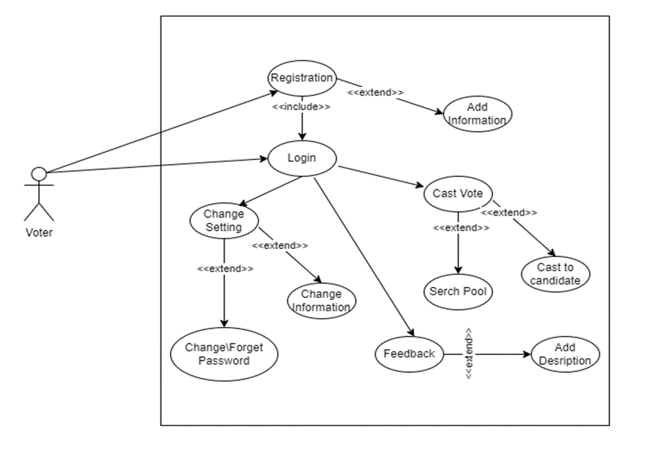
Use Case Diagram

Slide 18
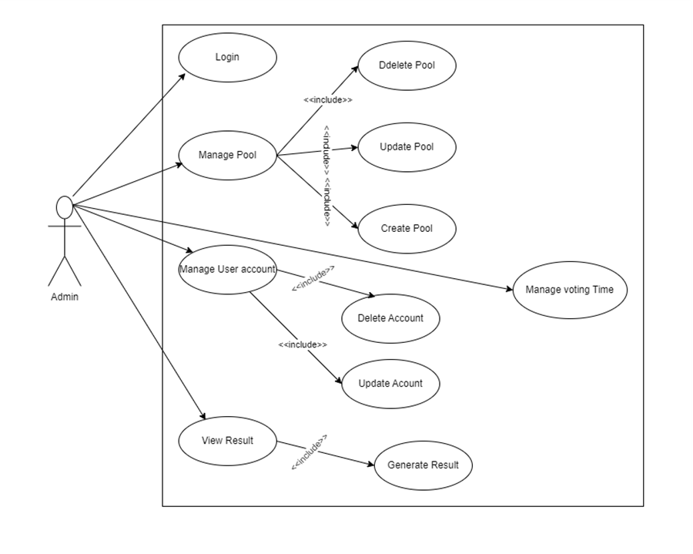

Slide 19
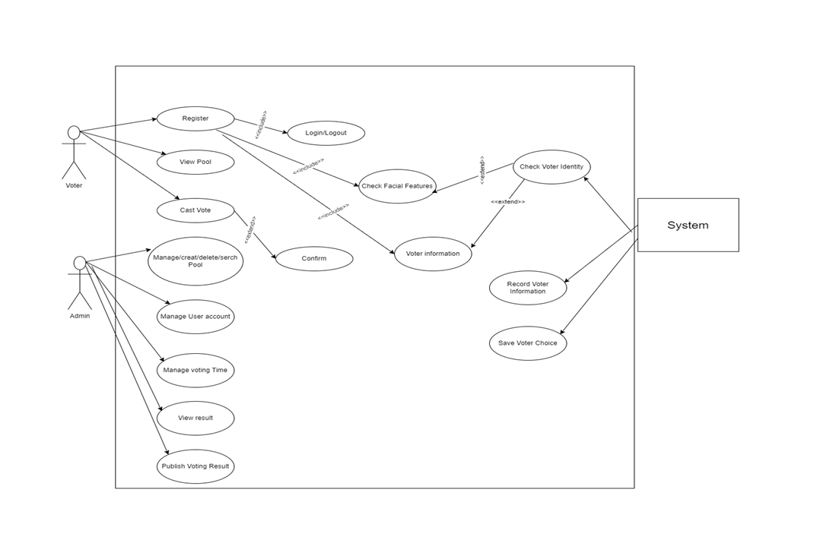

Slide 20
THANKS!
Does anyone have any question?
addyouremail@freepik.com
+92 3055792780
tazeemsajid22@gmail.com

